Slide 1
Local Area Networks

Slide 2
A LAN is a privately owned network that operates within and nearby a single building like a home, office or factory.
LANs are widely used to connect personal computers and consumer electronics to let them share resources (e.g., printers) and exchange information.

Slide 3
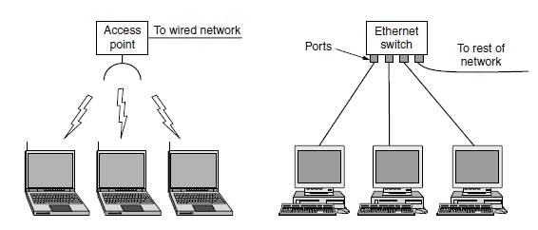
In most cases, each computer talks to a device in the ceiling as shown in Fig.
This device, called an AP (Access Point), wireless router, or base station, relays packets between the wireless computers and also between them and the Internet.
There is a standard for wireless LANs called IEEE 802.11, popularly known
as WiFi

Slide 4
The topology of many wired LANs is built from point-to-point links. IEEE 802.3, popularly called Ethernet.
Wired LANs use a range of different transmission technologies. Most of them use copper wires, but some use optical fiber.
Wired LANs run at speeds of 100 Mbps to 1 Gbps, have low delay (microseconds or nanoseconds), and make very few errors. Newer LANs can operate at up to 10 Gbps

Slide 5
Virtual Local Area Network (VLAN)
A virtual local area network (VLAN) is a logical group of workstations, servers and network devices that appear to be on the same LAN despite their geographical distribution.

Slide 6
Ad Hoc Network
An ad hoc network is a network that is composed of individual devices communicating with each other directly.
These networks often bypass the gatekeeping hardware or central access point such as a router.
Many ad hoc networks are local area networks where computers or other devices are enabled to send data directly to one another rather than going through a centralized access point.

Slide 7
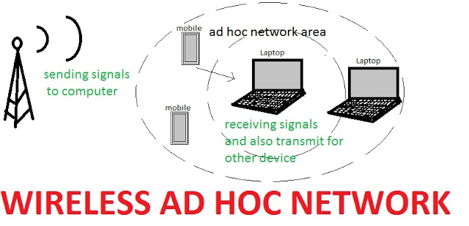
Wireless Ad Hoc (WANET) & Mobile Ad Hoc(MANET)

Slide 8
Media Access Control Protocols
CSMA Carrier-sense multiple access (CSMA) is a media access control (MAC) protocol in which a node verifies the absence of other traffic before transmitting on a shared transmission medium

Slide 9
Variations on basic CSMA include addition of Collision Avoidance (CSMA/CA) & Collision-Detection (CSMA/CD)
Collision Detection (CSMA/CD) CSMA/CD is used to improve CSMA performance by terminating transmission as soon as a collision is detected, thus shortening the time required before a retry can be attempted.

Slide 10
Collision Avoidance (CSMA/CA) - In CSMA/CA collision avoidance is used to improve the performance of CSMA. - If the transmission medium is sensed busy before transmission, then the transmission is deferred for a random interval. - This random interval reduces the likelihood that two or more nodes waiting to transmit will simultaneously begin transmission upon termination of the detected transmission, thus reducing the incidence of collision.

Slide 11
Carrier Sense Protocols
Protocols in which stations listen for a carrier (i.e., a transmission) and act accordingly are called carrier sense protocols
1-persistent CSMA
Non-persistent CSMA

Slide 12
1-persistent CSMA
When a station has data to send, it first listens to the channel to see if anyone else is transmitting at that moment. If the channel is idle, the stations sends its data. Otherwise, if the channel is busy, the station just waits until it becomes idle. Then the station transmits a frame. If a collision station waits a random amount of time and starts all over again

Slide 13
Non-Persistent CSMA
As before, a station senses the channel when it wants to send a frame, and if no one else is sending, the station begins doing so itself. However, if the channel is already in use, the station does not continually sense it for the purpose of seizing it immediately upon detecting the end of the previous transmission. Instead, it waits a random period of time and then repeats the algorithm.

Slide 14
Token Passing
A type of CAM. Token passing uses a token, or series of bits, to grant a device permission to transmit over the network.
Whichever device has the token can put data into the network. When its transmission is complete, the device passes the token along to the next device in the topology.

Slide 15
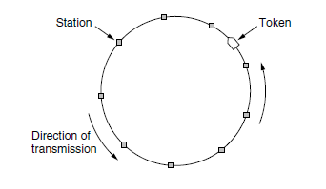
However, to stop the frame circulating indefinitely (like the token), some station needs to remove it from the ring. This station may be either the one that originally sent
the frame, after it has gone through a complete cycle, or the station that was the intended recipient of the frame.

Slide 16
IEEE 802 MAC Layer Standards
Many of the designs for personal, local, and metropolitan area networks have been standardized under the name of IEEE 802.
The most important of the survivors are IEEE 802.3 (Ethernet) and IEEE 802.11 (wireless LAN).

Slide 17
Ethernet
Two kinds 1 – Classic Ethernet 2 – Switched Ethernet
Classic Ethernet Classic Ethernet was indeed simple, and – mostly – passive. In its most basic form, the Ethernet medium was one long piece of coaxial cable, onto which stations could be connected via taps

Slide 18
Switched Ethernet in which devices called switches are used to connect different computers.
Classic Ethernet is the original form and ran at rates from 3 to 10 Mbps.
Switched Ethernet is what Ethernet has become and runs at 100, 1000, and 10,000 Mbps, in forms called fast Ethernet, gigabit Ethernet, and 10 gigabit Ethernet. In practice, only switched Ethernet is used nowadays.

Slide 19
IEEE 802.3
802.3 is a standard specification for Ethernet, a method of physical communication in a local area network (LAN), which is maintained by the Institute of Electrical and Electronics Engineers (IEEE).
In general, 802.3 specifies the physical media and the working characteristics of Ethernet.
The original Ethernet supports a data rate of 10 megabits per second (Mbps) and specifies these possible physical media:

Slide 20
10BASE-2 (Thin wire coaxial cable with a maximum segment length of 185 meters)
10BASE-5 (Thick wire coaxial cable with a maximum segment length of 500 meters)
10BASE-F (optical fiber cable)
10BASE-T (ordinary telephone twisted pair wire)
10BASE-36 (broadband multi-channel coaxial cable with a maximum segment length of 3,600 meters)

Slide 21
This designation is an IEEE shorthand identifier.
The "10" in the media type designation refers to the transmission speed of 10 Mbps.
The "BASE" refers to baseband signaling, which means that only Ethernet signals are carried on the medium.
The "T" represents twisted-pair.
The "F" represents fiber optic cable
The "2", "5", and "36" refer to the coaxial cable segment length (the 185 meter length has been rounded up to "2" for 200).

Slide 22
IEEE 802.11
802.11 is an evolving family of specifications for wireless local area networks (WLANs) developed by IEEE
All the 802.11 specifications use the Ethernet protocol and Carrier Sense Multiple Access with Collision Avoidance (CSMA/CA) for path sharing.
Wi-Fi is a term for certain types of wireless local area networks (WLAN) that use specifications in the 802.11

Slide 23
IEEE 802.15
802.15 is a communications specification for wireless personal area networks (WPANs).
The initial version, 802.15.1, was adapted from the Bluetooth specification and is fully compatible with Bluetooth 1.1.
Bluetooth is a well-known and widely used specification that defines parameters for wireless communications among portable digital devices

Slide 24
Two categories In 802.15 1 – TG4 version provides data speeds of 20 Kbps or 250 Kbps. 2 - TG3 version supports data speeds ranging from 11 Mbps to 55 Mbps

Slide 25
Switched Ethernet variants:
Fast Ethernet Classic Ethernet, at 10 Mbps, is quite slow by modern standards. Fast Ethernet is a local area network (LAN) transmission standard that provides a data rate of 100 megabits per second (referred to as "100BASE-T")

Slide 26
Gigabit Ethernet
A transmission technology based on the Ethernet frame format and protocol used in local area networks (LANs).
Provides a data rate of 1 billion bits per second (one gigabit).
Gigabit Ethernet is defined in the IEEE 802.3 standard and is currently being used as the backbone in many enterprise networks.

Slide 27
Gigabit Ethernet is carried primarily on optical fiber (with very short distances possible on copper media).
A newer standard, 10-Gigabit Ethernet, is also becoming available.

Slide 28
10-Gigabit Ethernet
10 gigabit Ethernet is a telecommunication technology that offers data speeds up to 10 billion bits per second.
10 gigabit Ethernet (10-Gigabit Ethernet) is also known as 10GE, 10GbE or 10 GigE

Slide 29
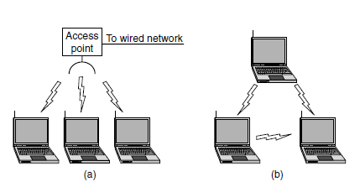
Wireless LANs 802.11

Slide 30
Access Method : CSMA/CA
Carrier Sensed Multi Access with Collision Avoidance mechanism is used in Wireless communication. Also known as the IEEE 802.11 standard.
WLAN is half-duplex communication. Meaning the Access Point can’t transmit and receive data simultaneously. Where as wired LAN communication is full-duplex and can Tx and Rx data simultaneously.

Slide 31
CSMA/CA is beneficial in wireless communication because multiple clients often cannot detect each other due to differences in the following:
- Transmit Power -Receive Sensitivity -Distance and location with respect to the AP
This is referred to as the “Hidden node” problem which causes WLAN clients not to be able to detect a collision and stop the transmission as in CSMA/CD

Slide 32
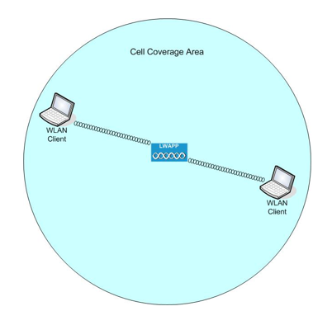

Slide 33
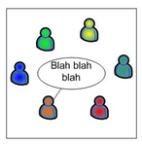
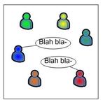
CSMA/CA Explained
One person speaks and others listen
Two person speaks simultaneously

Slide 34
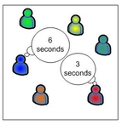
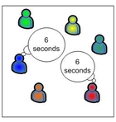
Both of them choose a random number
between a range. Here, MrRED will speak before MrBLUE
Both of them choose a random number
between a range. Here, Both choose same number and
again collision will take place

Slide 35
ISM Frequency Bands
Wi-Fi is aimed at use within unlicensed spectrum. This enables users to access the radio spectrum without the need for the regulations and restrictions that might be applicable elsewhere.
There are a number of unlicensed spectrum bands in a variety of areas of the radio spectrum.
Often these are referred to as ISM bands - Industrial, Scientific and Medical, and they carry everything from microwave ovens to radio communications.
Many of these bands, including he two used for Wi-Fi are global allocations.

Slide 36
The main bands used for carrying Wi-Fi are those in the table below:
2400 – 2500 MHz Often referred to as the 2.4 GHz band, this spectrum is the most widely used of the bands available for Wi-Fi. Used by 802.11b, g, & n. It can carry a maximum of three non-overlapping channels.

Slide 37
5725 – 5875 MHz This 5 GHz band or 5.8 GHz band provides additional bandwidth, and being at a higher frequency, equipment costs are slightly higher, although usage, and hence interference is less.It can be used by 802.11a & n. It can carry up to 23 non-overlapping channels, but gives a shorter range than 2.4 GHz.

Slide 38
Ad-Hoc vs. Infrastructure(managed)
Wireless networks typically work in one of two configurations (sometimes called topologies): ad-hoc or infrastructure. The topology or mode you choose depends on whether you want your PCs to communicate directly or with an access point.
In ad-hoc mode data in the network is transferred to and from wireless network adapters connected to PCs. An ad-hoc network is also called a peer-to-peer network.

Slide 39
Benefits of an ad-hoc network:
Ad-hoc networks are simple to set up. Plug in your wireless network adapters, configure the software, and you're off and running.
Ad-hoc networks are inexpensive. You save the cost of purchasing an access point.
Ad-hoc networks are fast. Throughput rates between two wireless network adapters are twice as fast as when you use an access point.

Slide 40

More common than an ad-hoc network, an infrastructure network includes an access point.

Slide 41
802.11 Variants
The 802.11 wireless standards can differ in terms of speed, transmission ranges, and frequency used, but in terms of actual implementation they are similar. All standards can use either an infrastructure or ad hoc network design, and each can use the same security protocols

Slide 42
IEEE 802.11a
In terms of speed, the 802.11a standard was far ahead of the original 802.11 standards.
802.11a specified speeds of up to 54Mbps in the 5GHz band, but most commonly, communication takes place at 6Mbps, 12Mbps, or 24Mbps.
802.11a is incompatible with the 802.11b and 802.11g wireless standards.

Slide 43
IEEE 802.11b
The 802.11b standard provides for a maximum transmission speed of 11Mbps.
However, devices are designed to be backward-compatible with previous 802.11 standards that provided for speeds of 1, 2, and 5.5Mbps.
802.11b uses a 2.4GHz RF range and is compatible with 802.11g.

Slide 44
IEEE 802.11g
802.11g is a popular wireless standard today.
802.11g offers wireless transmission over distances of 150 feet and speeds up to 54Mbps compared with the 11Mbps of the 802.11b standard.
Like 802.11b, 802.11g operates in the 2.4GHz range and therefore is compatible with it

Slide 45
IEEE 802.11n
The newest of the wireless standards listed is 802.11n.
The goal of the 802.11n standard is to significantly increase throughput in both the 2.4GHz and the 5GHz frequency range.
The baseline goal of the standard was to reach speeds of 100Mbps, but given the right conditions, it is estimated that the 802.11n speeds might reach a staggering 600Mbps. In practical operation

